Slide 1

BATCH - 08
BLOCKCHAIN DIGITISATION HUB
PROJECT GUIDE:
TEAM MEMBERS
Dr. G . Shyama Chandra Prasad
Professor and HOD
IT
Prateek Kumar Singh (1608-20-737-013)
Gottapu Sai Nitish (1608-20-737-020)
Ziauddin (1608-20-737-036)

Slide 2
BLOCKCHAIN DIGITISATION HUB
INTRODUCTION
1
MOTIVATION
2
CONTENTS
PROBLEM STATEMENT
3
LITERATURE SURVEY
4
SCOPE OF PROJECT
5
PROJECT PLANNING
6
REFERENCES
7

Slide 3
BLOCKCHAIN DIGITISATION HUB
INTRODUCTION
Commerce on the Internet has come to rely almost exclusively on financial institutions serving as trusted third parties to process electronic payments.
While the system works well enough for most transactions, it still suffers from the inherent weaknesses of the trust based model. Completely non-reversible transactions are not really possible, since financial institutions cannot avoid mediating disputes.

Slide 4
BLOCKCHAIN DIGITISATION HUB
MOTIVATION
Now a days the transactions are being processed using Cheques, Net Banking and payment Wallets. Payment wallet transactions involves third party of government.
These transactions allows centralized platform means power and rights are not to be equally distributed among all the participants in a system.
Performing transactions through Cheques, Net banking and payment Wallet Entail the receiver effectively authorizing the seller to “Pull” a payment from their account, passing through several financial intermediates in the process.

Slide 5
BLOCKCHAIN DIGITISATION HUB
DISADVANTAGES
OF EXISTING SYSTEM
These transactions offer less security.
There is a need of documentation.
Due to the involvement of third party there is a problem of “Double spending”.
It is not cost effective..

Slide 6
BLOCKCHAIN DIGITISATION HUB
PROBLEM STATEMENT
A purely peer-to-peer version of electronic cash would allow online payments to be sent directly from one party to another without going through a financial institution. Digital signatures provide part of the solution, but the main benefits are lost if a trusted third party is still required to prevent double-spending.
We propose a solution to the double-spending problem using a peer-to-peer network. The network timestamps transactions by hashing them into an ongoing chain of hash-based proof-of-work, forming a record that cannot be changed without redoing the proof-of-work.

Slide 7
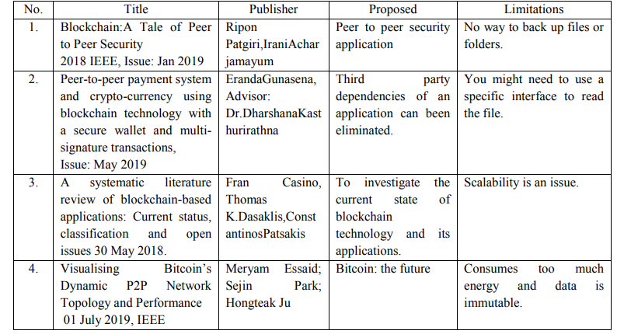

BLOCKCHAIN DIGITISATION HUB
LITERATURE SURVEY

Slide 8
BLOCKCHAIN DIGITISATION HUB
SCOPE OF PROJECT:
Decentralization: Enables trust and transparency by removing the need for central authorities.
Smart Contracts: Automates processes through self-executing contracts, reducing manual intervention.
Security and Immutability: Utilizes cryptographic techniques for heightened security and ensures tamper-proof records.
Interoperability: Facilitates seamless communication between diverse blockchain networks.
Industry-Specific Solutions: Tailored applications address unique needs across various industries.

Slide 9
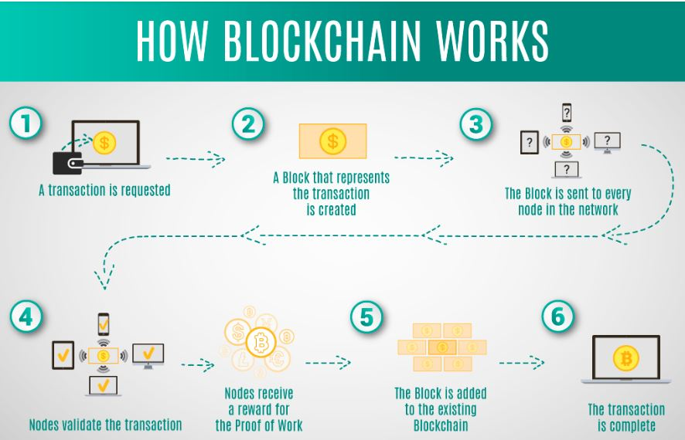
ARCHITECTURE
BLOCKCHAIN DIGITISATION HUB

Slide 10
BLOCKCHAIN DIGITISATION HUB
REFERENCES
S. Nakamoto et al., Bitcoin: a peer-to-peer electronic cash system
V. Buterin, On public and private blockchains (2015). https://blog.ethereum.org/2015/08/07/ on-public-and-private-blockchains/
M. Swan, Blockchain: Blueprint for a New Economy (O’Reilly Media, Newton, MA, USA, 2015); A.M. Antonopoulos, Mastering Bitcoin: Unlocking Digital Cryptocurrencies (O’Reilly Media, Newton, MA, USA, 2014)
https://www.fool.com/investing/stock-market/market-sectors/financials/cryptocurrency-stocks/proof-of-stake/

Slide 11
BLOCKCHAIN DIGITISATION HUB
REFERENCES
J. Fan, L.T. Yi, J.W. Shu, Research on the technologies of Byzantine system. J. Softw. 24(6), 1346–1360 (2013). Online available: http://www.jos.org.cn/1000-9825/4395.htm
T.T.A. Dinh, R. Liu, M. Zhang, G. Chen, B.C. Ooi, J. Wang, ‘Untangling blockchain: a data processing view of blockchain systems’. IEEE Trans. Knowl. Data Eng. 30(7), 1366–1385 (2018)
C. Natoli, V. Gramoli, The blockchain anomaly, in Proceedings of the 15th IEEE InternationalSymposium on Network Computing and Applications, NCA’16 (2016), pp. 310–317

Slide 12
T
H
A
N
K
Y
O
U

Slide 13
T
H
A
N
K
Y
O
U

